Slide 1
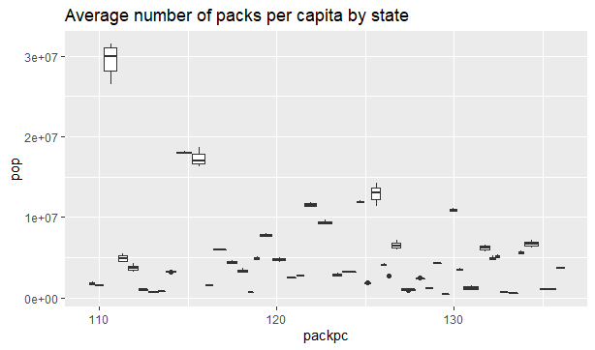
HANDS ON LESSON 10

Slide 2
HANDS ON LESSON 10 CODE
ggplot(Cigarette, aes(x = packpc, y = pop)) + geom_boxplot() +(aes(group = state)) + ggtitle("Average number of packs per capita by state")
arrange(Cigarette, packpc)
numpks_state <- select(Cigarette, state, packpc, year)
arrange(numpks_state,desc(packpc))
arrange(numpks_state, packpc)

Slide 3
HANDS ON LESSON 10
The states that have the highest pack per capita are New Hampshire and Kentucky.
The states that have the lowest pack per capita are Utah and California.

Slide 4
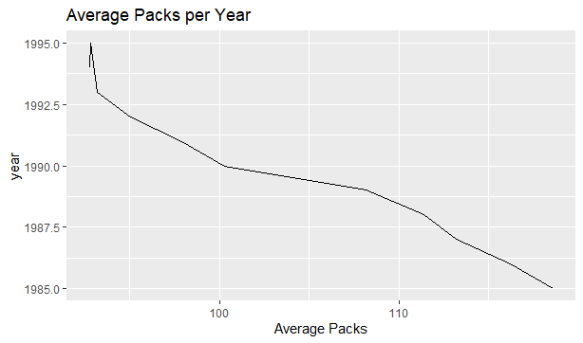
HANDS ON LESSON 10

Slide 5
HANDS ON LESSON 10 CODE
med_pks <- numpks_state %>% group_by(year) %>% summarize(ave.pks = median(packpc))
d<- ggplot(med_pks, aes(x = ave.pks, y = year))
d + geom_line() + ggtitle("Average Packs per Year") + xlab("Average Packs")

Slide 6
HANDS ON LESSON 10
From the previous chart you can see that cigarette usage went down over the decade of 1985 to 1995.
This can be seen by looking at the median average packs per year.

Slide 7
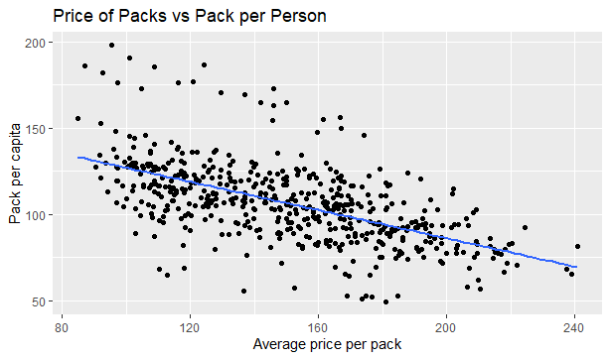
HANDS ON LESSON 10 SCATTERPLOT

Slide 8
HANDS ON LESSON 10 CODE
d <- ggplot(Cigarette, aes( x = avgprs, y = packpc))
d + geom_point() + ggtitle("Price of Packs vs Pack per Person") + xlab("Average price per pack") + ylab("Pack per capita")

Slide 9
HANDS ON LESSON 10
In the previous slide you can see that the average price per pack vs the pack per capita shows a slight negative correlation
This would be expected since the higher the price per pack the less packs per capita are sold. It seems that the higher price is a good motivation for people to stop or slow down.

Slide 10
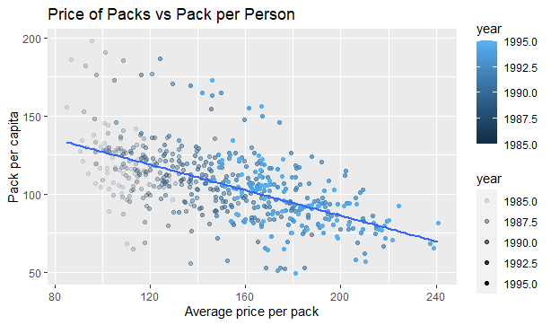
HANDS ON LESSON 10

Slide 11
HANDS ON LESSON 10 CODE
d <- ggplot(Cigarette, aes( x = avgprs, y = packpc, color = year))
d + geom_point(aes(alpha = year)) + geom_smooth(method = lm, se = FALSE) + ggtitle("Price of Packs vs Pack per Person") + xlab("Average price per pack") + ylab("Pack per capita")

Slide 12
HANDS ON LESSON 10
The relationship between the average price per pack vs pack per capita appear to stay the same over the years for the majority of the states.
When the price per pack starts to rise the pack per capita seems to decline.

Slide 13
HANDS ON LESSON 10
lm(formula = qsec ~ hp, data = mtcars)
Residuals:
Min 1Q Median 3Q Max
-2.1766 -0.6975 0.0348 0.6520 4.0972
Coefficients:
Estimate Std. Error t value Pr(>|t|)
(Intercept) 20.556354 0.542424 37.897 < 2e-16 ***
hp -0.018458 0.003359 -5.495 5.77e-06 ***
---
Signif. codes: 0 ‘***’ 0.001 ‘**’ 0.01 ‘*’ 0.05 ‘.’ 0.1 ‘ ’ 1
Residual standard error: 1.282 on 30 degrees of freedom
Multiple R-squared: 0.5016, Adjusted R-squared: 0.485
F-statistic: 30.19 on 1 and 30 DF, p-value: 5.766e-06

Slide 14
HANDS ON LESSON 10 CODE
lin_reg <- lm(avgprs ~ packpc)
lin_reg
summary(lin_reg)

Slide 15
HANDS ON LESSON 10
The R-squared value of the linear regression shows a 49%, this means that the two factors are less than half of the factors.
The rest of the variables have not been included in this model and account for 51% of the factors.

Slide 16
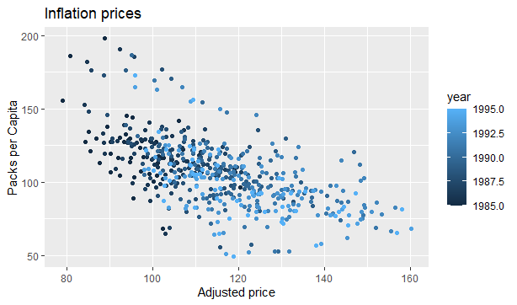
HANDS ON LESSON 10

Slide 17
HANDS ON LESSON 10 CODE
Cigarette2 <- Cigarette %>% mutate(priceadj = avgprs / cpi)
ggplot(Cigarette2, aes(x=priceadj, y=packpc)) + geom_point()
ggplot(Cigarette2, aes(x=priceadj, y=packpc, color = year)) + geom_point() +xlab( "Adjusted price") + ylab("Packs per Capita") +ggtitle("Inflation prices")
ciglm2 <- lm(packpc ~ priceadj, Cigarette2)
summary(ciglm2)

Slide 18
HANDS ON LESSON 10 CODE
df_1985 <- filter(Cigarette, year %in% c(1985))
df_1995 <- filter(Cigarette, year %in% c(1995))

Slide 19
HANDS ON LESSON 10 CODE
v_1985 <- c(116.48628, 128.53459, 104.52261, 100.36304, 112.96354, 109.27835, 143.85114,
122.18112, 127.23462, 113.74558, 103.01811, 123.20848, 137.63737, 116.68040,
186.03519, 127.55727, 115.67760, 120.97871, 128.11694, 128.00485, 112.90323,
130.37393, 117.04018, 104.25790, 155.28377, 105.46529, 107.38171, 197.99399,
116.52128, 88.74218, 141.95584, 116.66292, 127.59874, 127.13937, 119.45380,
117.70303, 132.78178, 127.20944, 106.59026, 129.83459, 115.10293, 68.04626,
134.00980, 145.28302, 96.22813, 107.87700, 112.84740, 129.39999)
v_1995 <- c(101.08543, 111.04297, 71.95417, 56.85931, 82.58292, 79.47219,
124.46660, 93.07455, 97.47462, 92.40160, 74.84978, 83.26508,
134.25835, 88.75344, 172.64778, 105.17613, 76.62064, 77.47355,
102.46978, 81.38825, 82.94530, 122.45028, 105.58245, 87.15957,
121.538061, 79.80697, 87.27071, 156.33675, 80.37137, 64.66887,
93.53612, 70.81732, 111.38010, 108.68011, 92.15575, 95.64309,
92.59980, 108.08275, 97.21923, 122.32005, 73.07931, 49.27220,
105.38687, 122.33475, 65.530921, 92.46635, 115.56883, 112.23814)

Slide 20
HANDS ON LESSON 10 CODE
cigarette3 <- data.frame(v_1985, v_1995)
d_test <- t.test(cigarette3$v_1985, cigarette3$v_1995, paired = TRUE)
d_test

Slide 21
HANDS ON LESSON 10
These are the results of the t-test:
Paired t-test
data: cigarette3$v_1985 and cigarette3$v_1995
t = 14.789, df = 47, p-value < 2.2e-16
alternative hypothesis: true difference in means is not equal to 0
95 percent confidence interval:
22.21141 29.20544
sample estimates:
mean of the differences
25.70842
According to this data we would reject the null hypothesis, meaning there is a significant difference in the pack per capita from 1985 to 1995.

Slide 22
HANDS ON LESSON 10
Is there a correlation between income and pack per capita?
According to the results from the correlation test and the scatter plot on the next slide, you can see there is a weak negative correlation between income and pack per capita.
It seems the less money you make the more likely you are to use cigarettes.

Slide 23
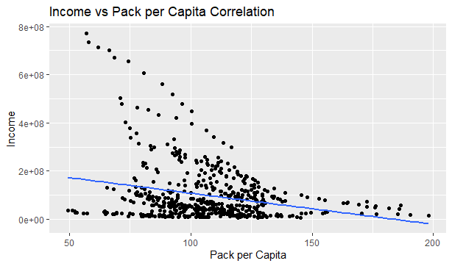
HANDS ON LESSON 10

Slide 24
HANDS ON LESSON 10 CODE
cor.test(Cigarette$income, Cigarette$packpc, method = "pearson", use = "complete.obs")
d <- ggplot(Cigarette, aes(x = packpc, y = income))
d + geom_point() + geom_smooth(method = lm, se = FALSE) + ggtitle("Income vs Pack per Capita Correlation") + xlab("Pack per Capita") + ylab("Income")
Pearson's product-moment correlation
data: Cigarette$income and Cigarette$packpc
t = -6.058, df = 526, p-value = 2.628e-09
alternative hypothesis: true correlation is not equal to 0
95 percent confidence interval:
-0.3334464 -0.1738376
sample estimates:
cor
-0.2553811

